Slide 1
Saint Joseph’s University
National Grocers Association
University Case Study Competition
2013

Slide 2



Introduction
Saint Joseph’s University
Food Marketing Program
  Lauren DeLeon
  Norene Drici
  Ed Fagan
  Mary Sisti
  Devin Tanney
Thank you for the opportunity!
Notes:
We are the team representing Saint Joseph’s University Food Marketing Program.
The team consists of 5 students – Lauren DeLeon, Norene Drici, Edward Fagan, Mary Sisti, and myself, Devin Tanney.
Thank you for the opportunity to share our findings.

Slide 3

Case Study Briefing
Chief Supermarkets:
Northwest and West Central Ohio
12 store chain
Company Mission Statement:
“Chief exists to delight our customers with great food and experiences.”
Problem:
Declining sales and customer count YTD
Given Objective:
Fulfill the company mission
Grow market share
Notes:
Displayed here is the problem and key points we were given to begin our research.
Each piece of information was utilized in order to help us form our problem definition.

Slide 4
Case Study Briefing
“Chief
exists to
delight
our
customers
with
great
food
and experiences.”
How can Chief act on the pieces of its mission in a way that can reverse sales erosion?
Notes:
These puzzle pieces represent the key aspects of Chief Supermarkets.
Throughout our presentation we will propose a strategy that will put these pieces together and bring the Chief mission statement to life.

Slide 5
Research & Analysis
Mintel Oxygen
Planet Retail
Progressive Grocer
Supermarket News
Food Marketing Institute
Ohio Grocers Association
Mosaic
NGA Consumer Panel Data
SIRS Marketing Research
Notes:
In order to clearly define the problem, we reviewed multiple sources of data.
As you can see, we looked at a wide variety and large quantity of information to ensure that we understood the whole picture.

Slide 6
Retail Marketing Mix
Customer Service
Store Design and Display
Communication Mix
Pricing
Merchandise Assortment
Location
Customer Analysis
Competitor Analysis
Market Analysis
Environmental Analysis
An Analysis of Chief
SWOT Analysis
Retail Marketing Mix
Analysis
Notes:
We performed multiple analyses based upon the data sources previously shown.
We also considered the retail marketing mix when developing the problem definition.

Slide 7
Problem Definition
Increased Competition
Lack of Differentiation
Market Share Erosion &
Loss of Sales
Difficulty Reaching & Engaging Customers
Notes:
We see three issues leading to market share erosion and loss of sales.
We worked with a loosely stated problem definition.
As can be seen in this diagram, there are three major factors contributing to the loss of sales and market share erosion that Chief has been experiencing.
Now we will expand a little further on the issues

Slide 8
Issue #1: Increased Competition
Growth of Alternative Retail Channels and Outlets
Favor supermarkets for fresh and perishable items
Dollar, Club, Mass channels becoming increasingly appealing
Consumers are Shopping Multiple Channels for Best Value
Comfortable buying shelf-stable items in non-grocery outlets
Mass merchandisers developing grocery departments
Shoppers driven by value offerings
Growth of local farmers’ markets
Mintel Oxygen 2011
Notes:
The first issue is increased competition in the marketplace.
This competition is giving shoppers several options when deciding where to purchase their groceries.
Our identification of increased competition as an issue is based on two factors:
The growth of alternative retail channels and outlets
as well as
The movement of consumers shopping multiple channels for best value
Mintel Oxygen Grocery Store Retailing US - January 2011

Slide 9
Issue #2: Reaching & Engaging Customers
“Our customers are bombarded with messages the entire time they are shopping. But often we don't communicate clearly…”
-Stephanie Skylar, Chief CEO
Focus Needed on Key Marketplace Trends
Minimal consumer education of signature product offerings
Chief Website is Difficult to Navigate
Overwhelming, non-engaging, not user friendly
Eg. Convenience
Lacking Value-added Communication In-store
Notes:
The Chief CEO, Stephanie Skylar was recently quoted, commenting on the various difficulties with in-store communication.
This relates to our second issue: reaching and engaging customers.
Our identification of this issue is based on three points:
The Chief website currently being difficult to navigate
The Focus needed on key marketplace trends
AND
Value-added communication lacking in-store

Slide 10
Issue #3: Lack of Differentiation
“Chief exists to delight our customers
with great food and experiences.”
- Chief Mission Statement
Translate Mission Statement Into Immediate Action
In-store, online, and in consumer communications
Missed Opportunities for In-store Engagement
Leverage tangible points of difference, specificity, and value proposition
Potential for in-store seating (WiFi)
Under Leveraging Signature Items
Opportunity to connect local suppliers and consumers
Notes:
Finally, our third issue is the lack of differentiation from other retailers.
This issue points to:
Chief’s mission statement has excellent potential, however it needs to be translated into tangible actions.
Chief is also missing opportunities for in-store engagement
AND
Under leveraging their signature items
These three issues help us formally define the problem that Chief faces.

Slide 11
Issues & Problem Definition
Chief not providing sufficient value compared to
alternative channels
to attract and retain shoppers
Increased Competition
Lack of Differentiation
Difficulty Reaching & Engaging Customers
Notes:
Based on the issues just outlined, we see the problem defined as Chief not achieving sales goals
due to not providing sufficient value
compared to alternative channels
to attract and retain shoppers.
THE DEFINITION OF THESE ISSUES and this problem will directly support the statement of our objective and the strategies to support it.
This will help us in the next steps.

Slide 12
Economics of Retail Sales
Total Sales =
Number of Shoppers
X Number of Trips
X Number of Items
X Average Prices
Increasing Market Share
& Sales
Notes:
To address the problem defined, we considered the economics of retail sales
we should be developing an objective and strategies that can impact these components of sales.
We should be trying to increase the number of shoppers and trips,
increase the number of items and basket size,
And increase average price per item.
If our strategies can impact these in a favorable way, the results should be increased sales for Chief.

Slide 13
Objective & Strategic Ideas
Create sufficient attraction to retain shoppers and prevent them from favoring alternative retailers
#1: Expand
Shopper Base
#2: Provide a
Strong In-store Experience
#3: Develop & Leverage Differentiated Offerings
Notes:
Based on the problem just defined, success will look like Chief creating sufficient attraction to retain shoppers and prevent them from favoring alternative retailers.
To achieve this objective, we propose three strategic ideas:
Expanding shopper base
Providing a strong in-store experience
Leveraging differentiated offerings
We believe pursuing this objective and these strategies will address the problem and issues we just reviewed.
We will expand on these strategies, but before we do that, we will speak briefly to the target customer.

Slide 14
Target Market Definition
Struggling Societies
16.4%
Pastoral Pride
11.9%
Families in Motion
27.9%
25 to 45 years old
Half have families with two or more children
Dual-income couples
Prefer local retailers to national chains
Households are without children
Price-sensitive
The nation’s least affluent group
Little interest in digital technology
45 to 75 years old
45 to 65 years old
Patronize discount department stores
Loyal to stores that provide the most value
Utilize Social Media
Enjoy home-cooked meals
Utilize the internet for business purposes
Wal-Mart Shoppers
Price-sensitive and brand-loyal
Incomes are less than $50,000
Few households have children at home
Mosaic 2012
Notes:
The strategies were developed to be relevant to the target shopper.
In reviewing the Mosaic data provided, we see three important groups listed here
in order of socio-economic status with percentage of population show.
These percentages were calculated by totaling the number of households of each consumer group within each of Chief’s 12 stores.
In reviewing these profiles, the main differences are income, shopping behavior, and lifestyle.
Our target segment will be Families in Motion. Our strategies will be most relevant to them because they prefer local retailers, they are dual income households with children and they enjoy home-cooked meals.
As we study Families in Motion, there are several trends relevant to this customer group.

Slide 15
Key Marketplace Trends
Economizing: Savings and Value
Convenience
Health & Wellness
Sales Erosion to Alternative Channels
Corporate Social Responsibility
Social Media
Growth of Private Label
Notes:
These are well established trends in our industry. These trends were drawn from several leading industry reports and studies.
These trends are relevant to Families in Motion and will inform our tactical development later.
We will not be further developing a social media program, but we will recommend leveraging Chief’s website and Facebook page within our tactics.
Instead we will focus on providing convenience and value to Chief’s shoppers.
Now that we have identified our target, and understand what is important to them we can now talk about our strategies and the tactics that will bring them to life.

Slide 16
Strategy #1: Tactics
Expand Shopper Base
Reconstruct Website
Define Loyalty Program Incentives and Expand Across all Stores
Maintain and Communicate a Calendar of Community Events
Increase Points of Contact
to Reach More Consumers
Notes:
Our first strategy is to expand shopper base.
To address this, we have identified four tactics:
Reconstruct website
Define loyalty program incentives and expand across all stores
Maintain and communicate a calendar of community events
Increase points of contact to reach more consumers
To illustrate our thinking, we will now elaborate on one of these tactics: Reconstruct Website

Slide 17
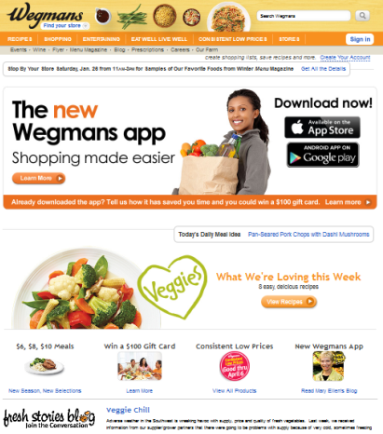
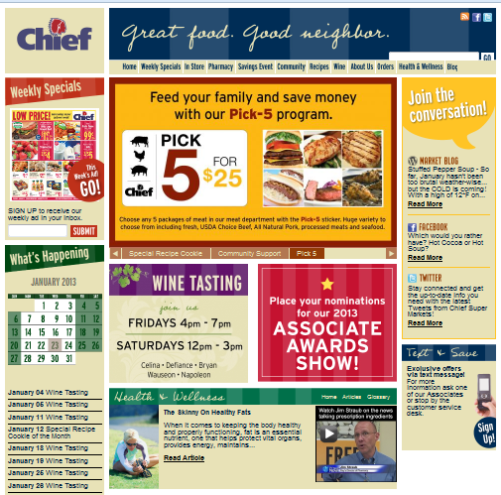
Tactic: Reconstruct Website
Restructure Information
Improve Navigation
Simplify Design
Reduce Clutter
Notes:
According to Mintel Oxygen, having a clear and strong website is extremely important 25% of shoppers gather information for shopping online.
We focused on the web page as it is the more immediate digital opportunity ahead of social.
When compared to industry leaders, there are opportunities to improve the Chief website.
Our following examples compare Chief to Wegmans, a best in class north-eastern retail chain.
Opportunities to improve the website include:
Improving navigation
Simplifying Design and Reducing Clutter
Clearly linking to other media and programs
Restructuring Information

Slide 18
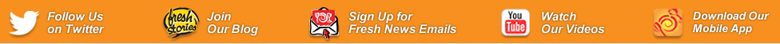
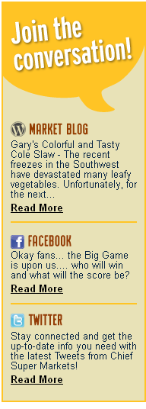
Tactic: Reconstruct Website
Reduce Wording
Utilize Larger Icons
Notes:
While your website currently invites the shoppers to “Join the Conversation,” there is an opportunity to be more effective and concise in its execution. Using larger icons and fewer words creates ease when linking to other media outlets.

Slide 19
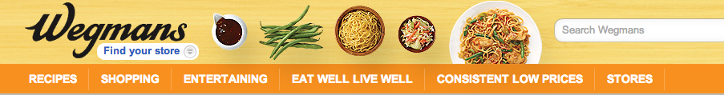

Tactic: Reconstruct Website
Create Broader Categories
Develop Fewer Tabs
Notes:
Furthermore, simplifying design through the use of fewer tabs and broader categories within the website banner will help to improve navigation.

Slide 20
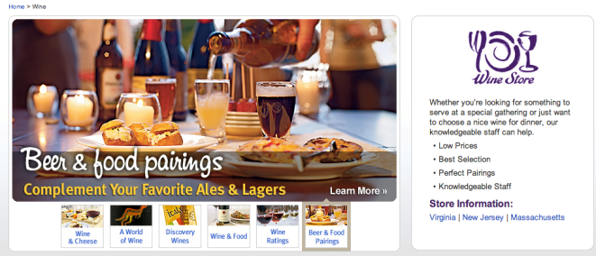
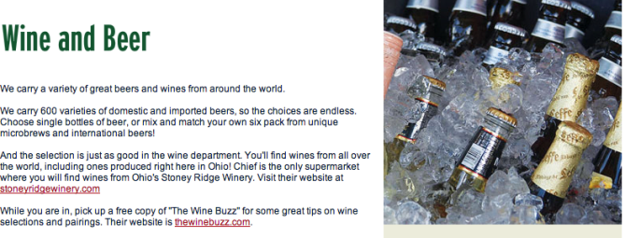
Tactic: Reconstruct Website
Utilize Stronger
Imagery
Provide
Value Added
Information
Notes:
Another way to improve the website is by utilizing stronger imagery and providing value added information to shoppers.
As can be seen in the example, Wegmans is offering beer and food pairing ideas.
Chief could provide similar suggestions for shoppers utilizing their unique wine and cheese products.

Slide 21
Strategy #2: Tactics
Develop & Leverage Differentiated Offerings
Highlight Seasonal and Locally Grown Produce
Elaborate and Communicate Company Mission
Develop Internal Competition to Motivate Employees and Promote Customer Service
Identify Signature Products that are Exceptionally Unique
Notes:
Our second strategy is develop and leverage differentiated offerings.
We have developed four tactics.
Identify Signature Products that are Exceptionally Unique
Highlight Seasonal and Locally Grown Produce
Elaborate and Communicate Company Mission
Develop Internal Competition to Motivate Employees and Promote Customer Service
We will expand on Identify Signature Products that are Exceptionally Unique

Slide 22
Tactic: Identify Signature Products & Services that are Unique
Signature
Products
Miller Amish Country Poultry
Fresh Pick of the Week
Differentiated Services
On-site Meat Cutter
Cookies Baked from Scratch
Domestic & Imported Beer
Locally Sourced Produce
Develop & Leverage:
Direct mail
Simplify and enhance signage
Announce on website
Prominent display
Cross merchandise
→ Focus on Meat & Produce
Notes:
Key signature products are a great way to demonstrate differentiation.
Chief currently has several signature items that they can exploit in order to increase sales.
For example, Chief can develop and leverage these offerings through the following tactics:
Direct Mail
Simplify and enhance signage
Call out on website
Prominent display
Cross Merchandise
With a special focus on Chief’s meat and produce.

Slide 23
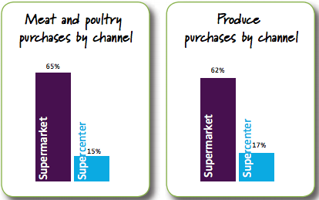
Tactic: Identify Signature Products & Services that are Unique
Meat, poultry, and produce are key areas where Chief
can win against mass and discount merchandisers.
Food Marketing Institute 2011
Notes:
FMI states that two-thirds of shoppers buy meat, poultry and produce at a supermarket versus a supercenter
Perishables are a key area where independents can beat mass retailers and discounters.

Slide 24
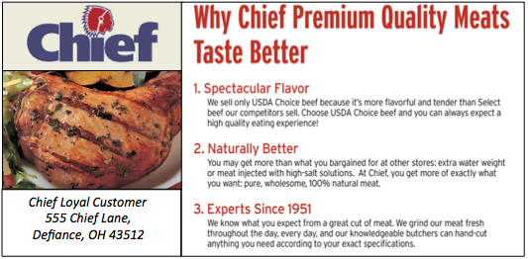
Tactic: Identify Signature Products & Services that are Unique
Sample Direct Mailer
Notes:
An example of leveraging Chief’s signature items would be to devote Direct Mailers to these products.
This is a sample we created to highlight Chiefs Premium meats.

Slide 25
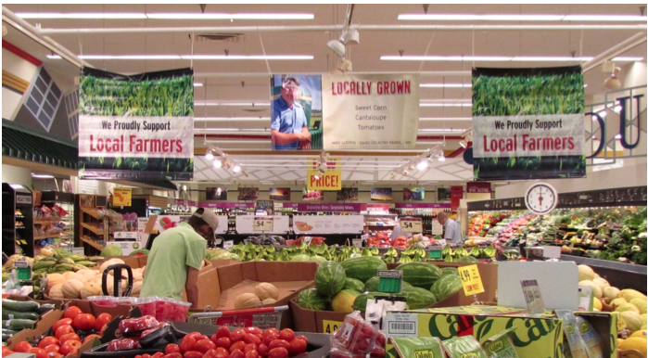
Tactic: Identify Signature Products & Services that are Unique
Tactic: Identify Signature Products & Services that are Unique
ç
Notes:
Chief has an exceptional produce department, which prides itself on locally grown products.
This is an image from the Defiance, Ohio location.
It is important to educate shoppers on the local products available, but we suggest doing so through organized product arrangement, focused signage near product, and prominent merchandise displays.

Slide 26
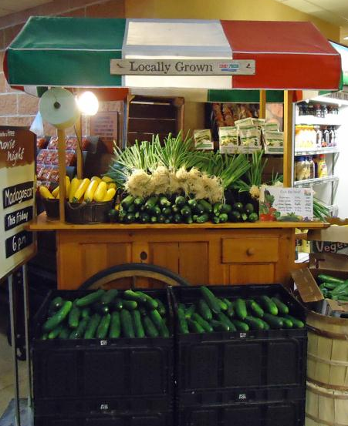
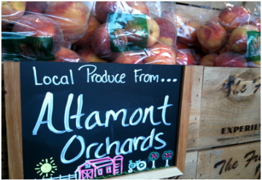
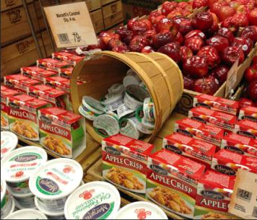
Tactic: Identify Signature Products & Services that are Unique
Notes:
Here is an example of how Chief can enhance the produce department through:
Tightly merchandised displays
Clear and specific signage near the producs
Cross merchandising with seasonal produce

Slide 27
Strategy #3: Tactics
Provide a Strong
In-Store Experience
Provide Solution Merchandising
Integrate Sampling Events for Signature Items and Weekly Recipes
Present Focused and Integrated
In-Store Signage and Communication
Offer In-Store Seating Area with Complementary WiFi
Notes:
Our third strategy is providing a strong in-store experience.
We have identified four tactics.
Provide Solution Merchandising
Integrate Sampling Events for Signature Items and Weekly Recipes
Present Focused and Integrated In-Store Signage and Communication
Offer In-Store Seating Area with Complementary WiFi
We will now elaborate on Providing Solution Merchandising

Slide 28
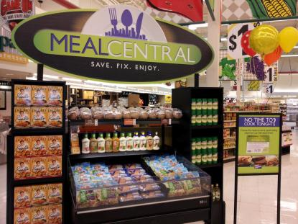
Tactic: Provide Solution Merchandising
Integrated Solutions
  Central Combined Display
    Recipe Cards
    Sampling Events
    Seasonal Solutions
    Combo Price
    Food and Non-food Items
  Announce on Digital Platforms
  Meal Center Calendar
  Communicate Externally to Shoppers
  Communicate Internally to Merchandise Departments
Notes:
Our next tactic, Solution Merchandising, is directed towards increasing transactions and overall basket size.
Execution would entail gathering all ingredients and items in one location to provide convenience for the shopper.
These integrated solutions will include recipe cards, sampling events, and seasonal items.
In addition, in order to make shoppers aware, we recommend having an in-store calendar, announcing the event on the Chief Website, and updating the company’s Facebook status.
We chose not to further develop their social media platform, your Facebook can be leveraged in opportunities such as this.
We also recommend having a calendar internally for employees to aid in the coordination of involved departments.

Slide 29

Tactic: Provide Solution Merchandising
Rotating Merchandising Themes
  Struggling Society:
    Center Store, PL Items
  Families in Motion:
    Signature, Local Items
  Pastoral Pride:
    National Brands
Notes:
In order to incorporate the three important groups within the target market. We suggest rotating merchandising themes throughout the store, using items relevant to each consumer group.
For example, the struggling society segment will purchase Private Label item, therefore, it is important to utilize these in your meal center.
We recommend offering several integrated solutions including food and non-food cross merchandising that would be tailored directly to the target market’s interest.
For example a tailgating or camping themed solution

Slide 30

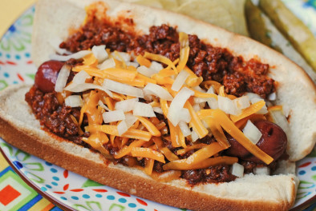
Tactic: Provide Solution Merchandising
Chili Dogs
Ingredients:
1 lb lean ground beef
1 jar chili sauce
1 packet chili seasoning
¼ cup water
1 tsp Worcestershire sauce
1 tbsp yellow mustard
½ tsp onion powder
8 beef hot dogs
8 hot dog buns
Shredded cheddar cheese
Diced red onion
Participating Departments:
  Grocery
  Deli
  Meat
  Bakery
  Non-food Items
Notes:
This chili dog recipe is from the Chief Website. It is a great tailgating recipe, which is attractive to Chief’s target market. Non-food items such as charcoal and paper goods can be used in the display.
During the scheduled period of time, the participating departments would contribute the necessary items for this recipe.
Recipe cards, like the one show here, will be available for all shoppers.
Sampling events for the meal will also be present during the week it is in rotation

Slide 31
Economics of Retail Sales
Expand Shopper Base
Total Sales =
Number of Shoppers
X Number of Trips
X Number of Items
X Average Prices
Provide a Strong
In-store Experience
Develop & Leverage Differentiated Offerings
Notes:
NORENE: We believe these strategies will have a direct impact on the economics of sales growth.
These are also the dimensions we should use to measure the success of our programs during implementation.
ED: As we take a deeper look at the economics of this, we look at the cost of the strategies and the sales impact that were just presented to you and we modeled the potential sales impact.

Slide 32
Program Costs
Expand Shopper Base $2.3 MM Provide a Strong In-Store Experience $1.5 MM
Develop & Leverage Differentiated Offerings $0.2 MM
Total Cost of Strategies $4.0 MM
Strategy | Year 1 | Year 2
Expand Shopper Base | - | $2.3 MM
Provide a Strong In-Store Experience | $0.8 MM | $0.7 MM
Develop & Leverage Differentiated Offerings | $0.2 MM | -
Total | $1.0 MM | $3.0 MM
Notes:
To begin with program costing,
we interviewed an advertising,
retail,
and sales executive
to begin to understand costs
and calculate an estimate for each of our proposed tactics.
The overall cost of proposed strategies is 4 MM dollars
This total consists of our three individual strategies and
The four corresponding tactics for each
This amount was proportionally spread
over our proposed two year program schedule
to arrive at estimate costs for Year 1 and 2.
We recognize this is a large investment,
therefore,
we have measured the projected impact of these strategies.
From FMI
19.5*27% (Gross Margin) = 5.3…..over 5 million in net revenue from the strategies
Spend 4 million to gain 5 million in the first year (but there will be a future gain)
The goal is to prevent erosion

Slide 33
Projected Marketing Impact
Average Annual Sales per sqft $550.16
Total Retail sqft Chief 354,485 sqft
Fair Market Avg. Annual Sales Chief $195,023,468
+5% | +10% | +15%
$9.7 MM | $19.5 MM | $29.3 MM
Low Impact | Medium Impact | High Impact
Food Marketing Institute 2011
Notes:
From FMI, average annual sales per square foot is roughly $550 dollars
From Chief data, total square footage is roughly 355,000 square feet.
Based on this, Chief’s Average Annual Sales should be approximately $195 million.
If our programs had a lower than average impact on sales, the impact could be a 9.7 million sales lift.
If the programs had a higher than average impact on sales, the impact could be a 29.3 million.
However, an average impact would be around 19.5 million dollars.
Based on our estimates, Chief will have the opportunity to increase their annual sales by $19.5MM with an investment of $4MM
With gross margin considered, Chief will have the opportunity to increase net revenue by 5MM in the next two years with our recommended programs.

Slide 34
Program Schedule
 | Q1-Q2 | Q3-Q4 | Q5-Q6 | Q7-Q8
Strategy 1: Expand the shopper base
Define loyalty program incentives and expand to all stores
Reconstruct website
Maintain and communicate a calendar of community events
Increase points of contact to reach more consumers
Strategy 2: Provide a strong in-store experience
Provide solution merchandising
Offer in-store seating area with complimentary WiFi
Integrate sampling events for signature items and weekly recipes
Present focused & integrated in-store signage and communication
Strategy 3: Develop & leverage differentiated offerings
Highlight seasonal and locally grown produce.
Identify and promote signature items that are exceptionally unique
Elaborate and communicate company mission
Develop internal competition to motivate employees and Improve customer service
Notes:
Our recommended tactics should be executed in a logical sequence as follows:
First, differentiate through products and programs
Then, improve in-store experience.
Lastly, communicate developments to customers.
This exhibit shows this pacing over a two-year period.
Although the strategies become more expensive in Q5-Q6, there is a strong push for communication at this time.

Slide 35
Issues
Problem
Objective
Strategies
Tactics
Create sufficient attraction to retain shoppers and prevent them from favoring alternative retailers
Expand Shopper Base
Provide a Strong
In-store Experience
Develop & Leverage Differentiated Offerings
Website
Loyalty Program
Community Calendar
Increase Points of Contact
Signature Products
Produce
Company Mission
Internal Competition
Solution Merchandising
Sampling
In-Store Communication
In-Store Seating
Chief not providing sufficient value compared to
alternative channels
to attract and retain shoppers
Increased Competition
Lack of Differentiation
Difficulty Reaching & Engaging Customers
Notes:
In conclusion, from our thorough research and data analysis,
we identified three major issues contributing to the problem.
We established an objective and set of strategies that,
if implemented through our recommended tactics,
could directly address the market share erosion and loss of sales for Chief Super Markets.

Slide 36
Conclusion
“Chief
exists to
delight
our customers
Signature Products
Customer Base
Develop & Leverage Differentiated Offerings
Expand Shopper Base
with
great
food
In-store Experience
and experiences.”
Provide a Strong
In-store Experience

Slide 37
Conclusion
“Chief
exists to
delight
our customers
with
great
food
and experiences.”
Notes:
As we return to our initial puzzle, you can see that the strategies presented fulfill Chief’s mission statement through tangible realities. Combining these pieces in a meaningful way will help to bring value to both Chief and their shoppers. The bigger picture reveals long-term success for Chief’s.

Slide 38
Thank you!
Notes:
Thank you for your time, we will now take any questions.

Slide 39
Appendix
Notes:
Unique food offerings
Unmatched experience
Solutions
Value
Delight Customers

Slide 40
(000s) | Q1-Q2 |  |  | Q3-Q4 |  |  | Q5-Q6 |  |  | Q7-Q8 |  |  | TOTAL
Strategy 1: Expand the shopper base.
Define loyalty program incentives and expand to all stores.
 |  |  |  |  |  |  | 175 |  |  | 175 |  |  | 250
Reconstruct website.
 |  |  |  |  |  |  | 25 |  |  | 25 |  |  | 50
Maintain and communicate a calendar of community events.
 |  |  |  |  |  |  | 25 |  |  |  |  |  | 25
Increase points of contact to reach more consumers.
 |  |  |  |  |  |  | 2000 |  |  |  |  |  | 2,000
Strategy 1 Cost |  |  |  |  |  |  |  |  |  |  |  |  | 2,325
Strategy 2: Provide a strong in-store experience.
Provide solution merchandising.
 |  |  |  | 500 |  |  | 500 |  |  |  |  |  | 1,000
Offer in-store seating area with complimentary WiFi.
 |  |  |  | 120 |  |  |  |  |  |  |  |  | 120
Integrate sampling events for signature items and weekly recipes.
 |  |  |  | 150 |  |  | 150 |  |  |  |  |  | 300
Present focused & integrated in-store signage and communication.
 |  |  |  | 25 |  |  | 25 |  |  |  |  |  | 50
Strategy 2 Cost |  |  |  |  |  |  |  |  |  |  |  |  | 1,470
Strategy 3: Develop and Leverage differentiated offerings.
Highlight seasonal and locally grown produce.
 | 50 |  |  |  |  |  |  |  |  |  |  |  | 50
Identify and promote signature items that are exceptionally unique.
 | 75 |  |  |  |  |  |  |  |  |  |  |  | 75
Elaborate and communicate company mission.
 | 40 |  |  |  |  |  |  |  |  |  |  |  | 40
Develop internal competition to motivate employees and improve customer service.
 | 20 |  |  | 20 |  |  |  |  |  |  |  |  | 40
Strategy 3 Cost |  |  |  |  |  |  |  |  |  |  |  |  | 205
Total Cost | 185 |  |  | 815 |  |  | 2900 |  |  | 200 |  |  | 4,000
Notes:
Big communication push in Q5-Q6

